Slide 1
A complete guide to programming in c++
Chapter 3 – Using functions and classes

Slide 2
This chapter describes how to
declare and call standard functions and
use standard classes.
This includes using standard header files. In addition, we will be working with string variables, i.e. objects belonging to the standard class string for the first time.

Slide 3
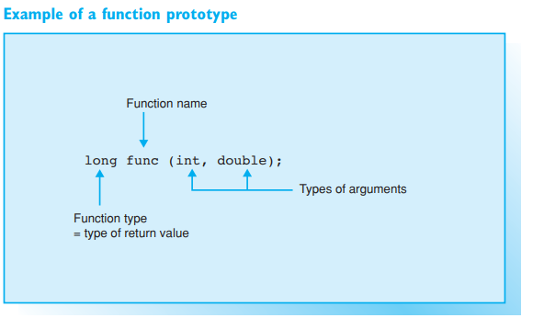
Declaring functions
The prototype on the right yields the following information to the compiler:
func is the function name
the function is called with two arguments: the first argument is of type int, the second of type double
the return value of the function is of type long

Slide 4
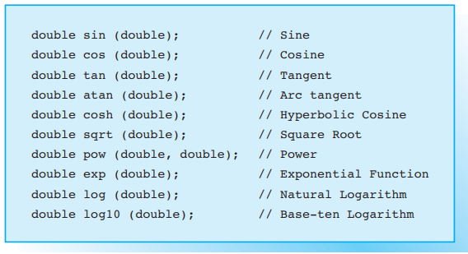
Mathematical standard functions

Slide 5
Declarations
Each name (identifier) occurring in a program must be known to the compiler or it will cause an error message. That means any names apart from keywords must be declared, i.e. introduced to the compiler, before they are used.
Each time a variable or a function is defined it is also declared. But conversely, not every declaration needs to be a definition. If you need to use a function that has already been introduced in a library, you must declare the function but you do not need to redefine it.

Slide 6
Declaring Functions
A function has a name and a type, much like a variable. The function’s type is defined by its return value, that is, the value the function passes back to the program. In addition, the type of arguments required by a function is important.
When a function is declared, the compiler must therefore be provided with information on
the name and type of the function
the type of each argument.
This is also referred to as the function prototype.
EXAMPLE

Slide 7
Function calls
A function call is an expression of the same type as the function and whose value corresponds to the return value. The return value is commonly passed to a suitable variable
EXAMPLE

Slide 8
TYPE void FOR FUNCTIONS
You can also write functions that perform a certain action but do not return a value to the function that called them. The type void is available for functions of this type, which are also referred to as procedures in other programming languages
EXAMPLE
If a function does not expect an argument, the function prototype must be declared as void or the braces following the function name must be left empty
EXAMPLE

Slide 9
Usage of srand() and rand()
The function prototypes for srand() and rand() can be found in both the cstdlib and stdlib.h header files.
Calling the function rand() without previously having called srand() creates the same sequence of numbers as if the following statement would have been proceeded:
srand(1);
If you want to avoid generating the same sequence of random numbers whenever the program is executed, you must call srand() with a different value for the argument whenever the program is run. It is common to use the current time to initialize a random number generator.

Slide 10
Header files
Header files are text files containing declarations and macros. By using an #include directive these declarations and macros can be made available to any other source file, even in other header files.
Pay attention to the following points when using header files:
header files should generally be included at the start of a program before any other declarations
you can only name one header file per #include directive
the file name must be enclosed in angled brackets < ... > or double quotes " ... "

Slide 11
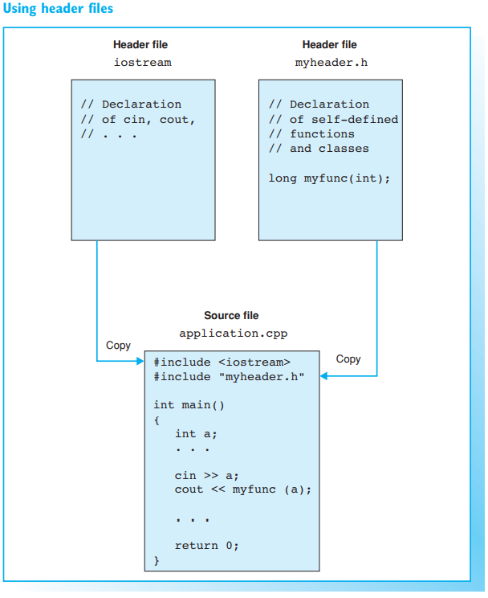
Using header files

Slide 12
Searching for header files
The header files that accompany your compiler will tend to be stored in a folder of their own—normally called include.
If the name of the header file is enclosed by angled brackets < ... >, it is common to search for header files in the include folder only. The current directory is not searched to increase the speed when searching for header files.
C++ programmers commonly write their own header files and store them in the current project folder. To enable the compiler to find these header files, the #include directive must state the name of the header files in double quotes.
EXAMPLE

Slide 13
Standard Class Definitions
In addition to standard function prototypes, the header files also contain standard class definitions. When a header file is included, the classes defined and any objects declared in the file are available to the program.
EXAMPLE

Slide 14
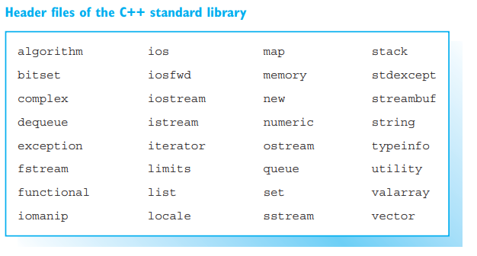
Standard header files
The C++ standard library header files are shown on the right. They are not indicated by the file extension .h and contain all the declarations in their own namespace, std.
EXAMPLE

Slide 15
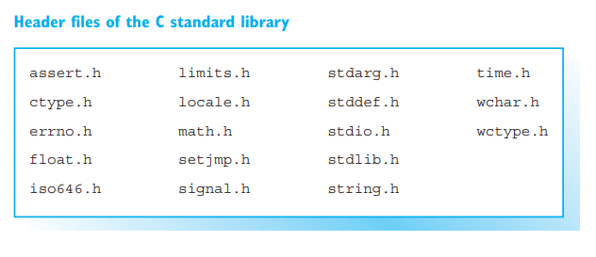
Header Files in the C Programming Language
The header files standardized for the C programming language were adopted for the C++ standard and, thus, the complete functionality of the standard C libraries is available to C++ programs
EXAMPLE

Slide 16
Using standard classes
Several classes are defined in the C++ standard library. These include stream classes for input and output, but also classes for representing strings or handling error conditions. Each class is a type with certain properties and capacities.
As previously mentioned, the properties of a class are defined by its data members and the class’s capacities are defined by its methods. Methods are functions that belong to a class and cooperate with the members to perform certain operations. Methods are also referred to as member functions.

Slide 17
Creating Objects
An object is a variable of a class type, also referred to as an instance of the class. When an object is created, memory is allocated to the data members and initialized with suitable values
EXAMPLE

Slide 18
Calling Methods
All the methods defined as public within the corresponding class can be called for an object. In contrast to calling a global function, a method is always called for one particular object. The name of the object precedes the method and is separated from the method by a period.
EXAMPLE

Slide 19
Classes and Global Functions
Globally defined functions exist for some standard classes. These functions perform certain operations for objects passed as arguments. The global function getline(), for example, stores a line of keyboard input in a string.
EXAMPLE

Slide 20
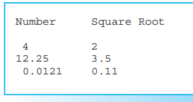
Exercises
Exercise 1)
Create a program to calculate the square roots of the numbers
4 12.25 0.0121
and output them as shown.
Then read a number from the keyboard and output the square root of this number.
To calculate the square root, use the function sqrt(), which is defined by the following prototype in the math.h (or cmath ) header file:
double sqrt( double x);
The return value of the sqrt() function is the square root of x

